Slide 1
Emerging Technologies for the Circular Economy
Lecture 1: Introduction
Prof. Dr. Benjamin Leiding (Clausthal)
Dr. Arne Bochem (Göttingen)
M.Sc. Anant Sujatanagarjuna (Clausthal)
M.Sc. Shohreh Kia (Clausthal)
Notes:
<number>

Slide 2
License
This work is licensed under a Creative Commons Attribution-ShareAlike 4.0 International License. To view a copy of this license, please refer to https://creativecommons.org/licenses/by-sa/4.0/ .
Updated versions of these slides will be available in our Github repository.

Slide 3
Motivation

Slide 4
Question 1
How old are you?
→ Type your response in the poll field.

Slide 5
Question 2
Are you involved in any climate change or sustainability movement / organization / party / etc. – if yes, which one?
No? → Type “no”
Yes? → Type the name/abbreviation, e.g., “XR” (Extinction Rebellion), “FF” (Fridays for Future), etc.

Slide 6
Question 3
Would you like to attend the lecture and Q&A live in Goslar?
Yes
No

Slide 7

The Limits to Growth – 1972

Slide 8
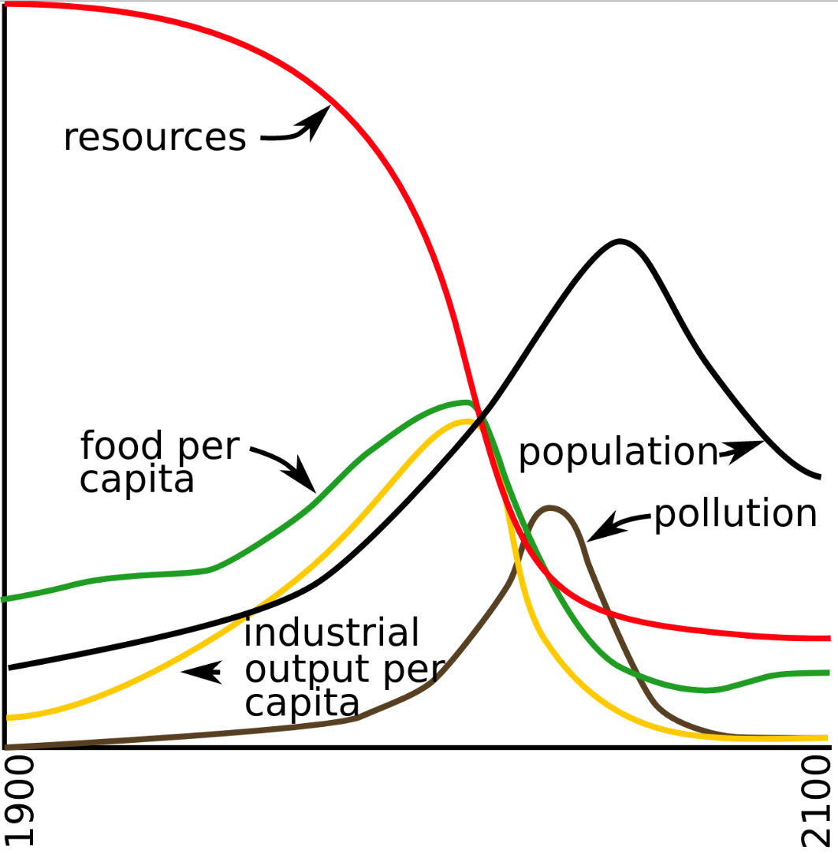
The Limits to Growth – World3 Standard Run
Reconstruction by YaguraStation of Figure 35. page 124 of The Limits to Growth (1972) is licensed with CC BY-SA 4.0. To view a copy of this license, visit https://creativecommons.org/licenses/by-sa/4.0/

Slide 9
The Limits to Growth – World3 Standard Run
Click Me
Meadows (1972) – The Limits to Growth.

Slide 10
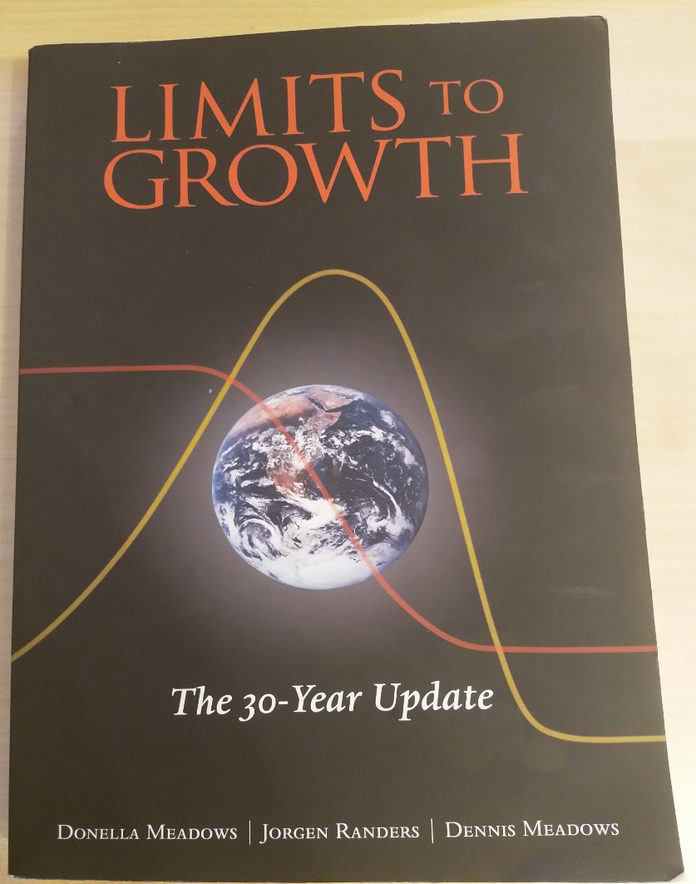
The Limits to Growth – 1972 / 2004

Slide 11

We only have one planet – Resource Consumption
Earth Overshoot Day
1970-2021
1 Earth
1.7 Earths
December
November
October
September
August
July
June
May
April
March
February
January
Figure adapted from https://www.overshootday.org/newsroom/past-earth-overshoot-days/

Slide 12
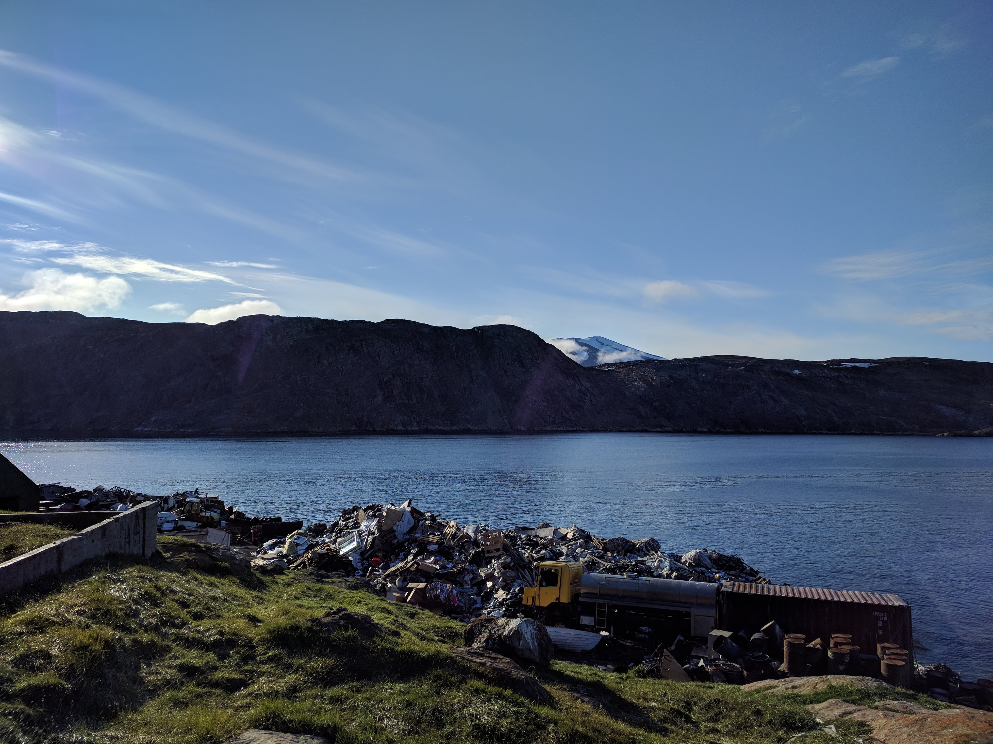
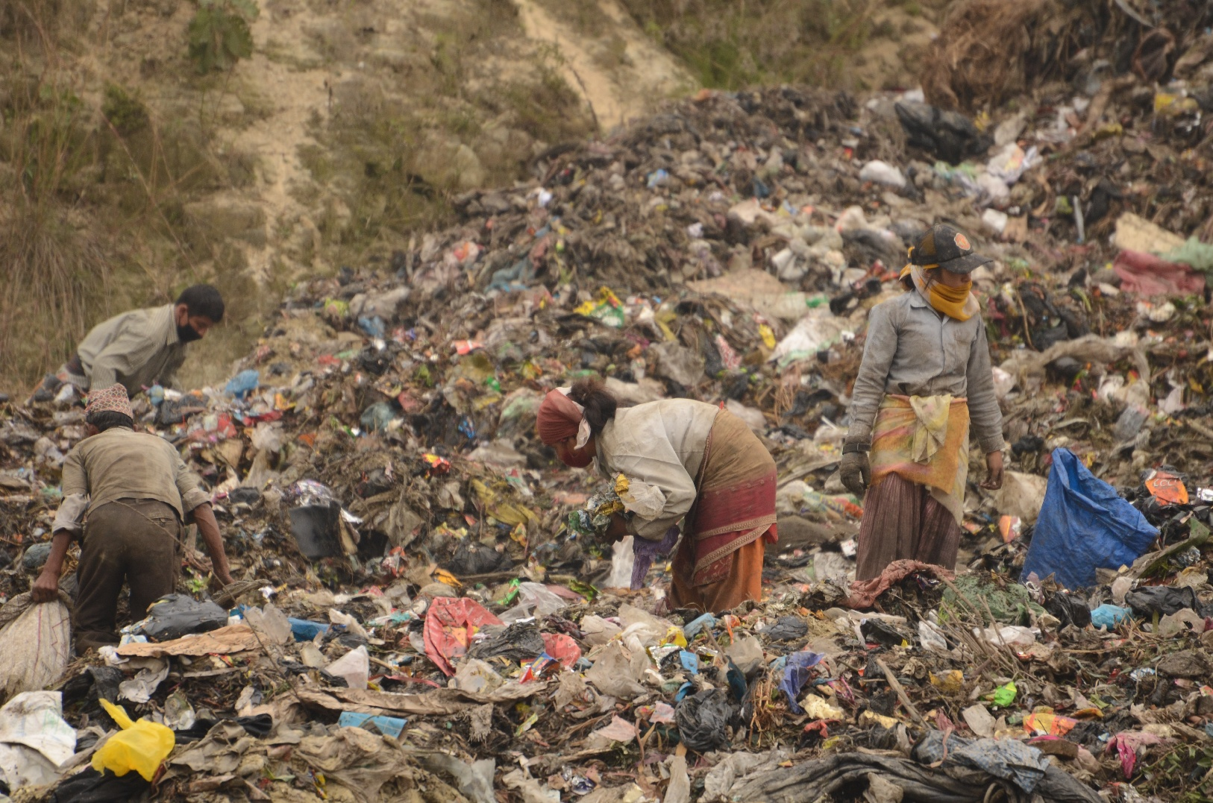
We only have one planet – Environmental Pollution
1. "Landfill at Upernavik" by ulalume – https://www.flickr.com/photos/96649248@N00/43867280734 – CC BY-NC-ND 2.0 (https://www.creativecommons.org/licenses/by-nc-nd/2.0/).
2. Christian Hüpfer – https://flic.kr/p/aKXw2F – CC BY-SA 2.0 (https://creativecommons.org/licenses/by-sa/2.0/).

Slide 13
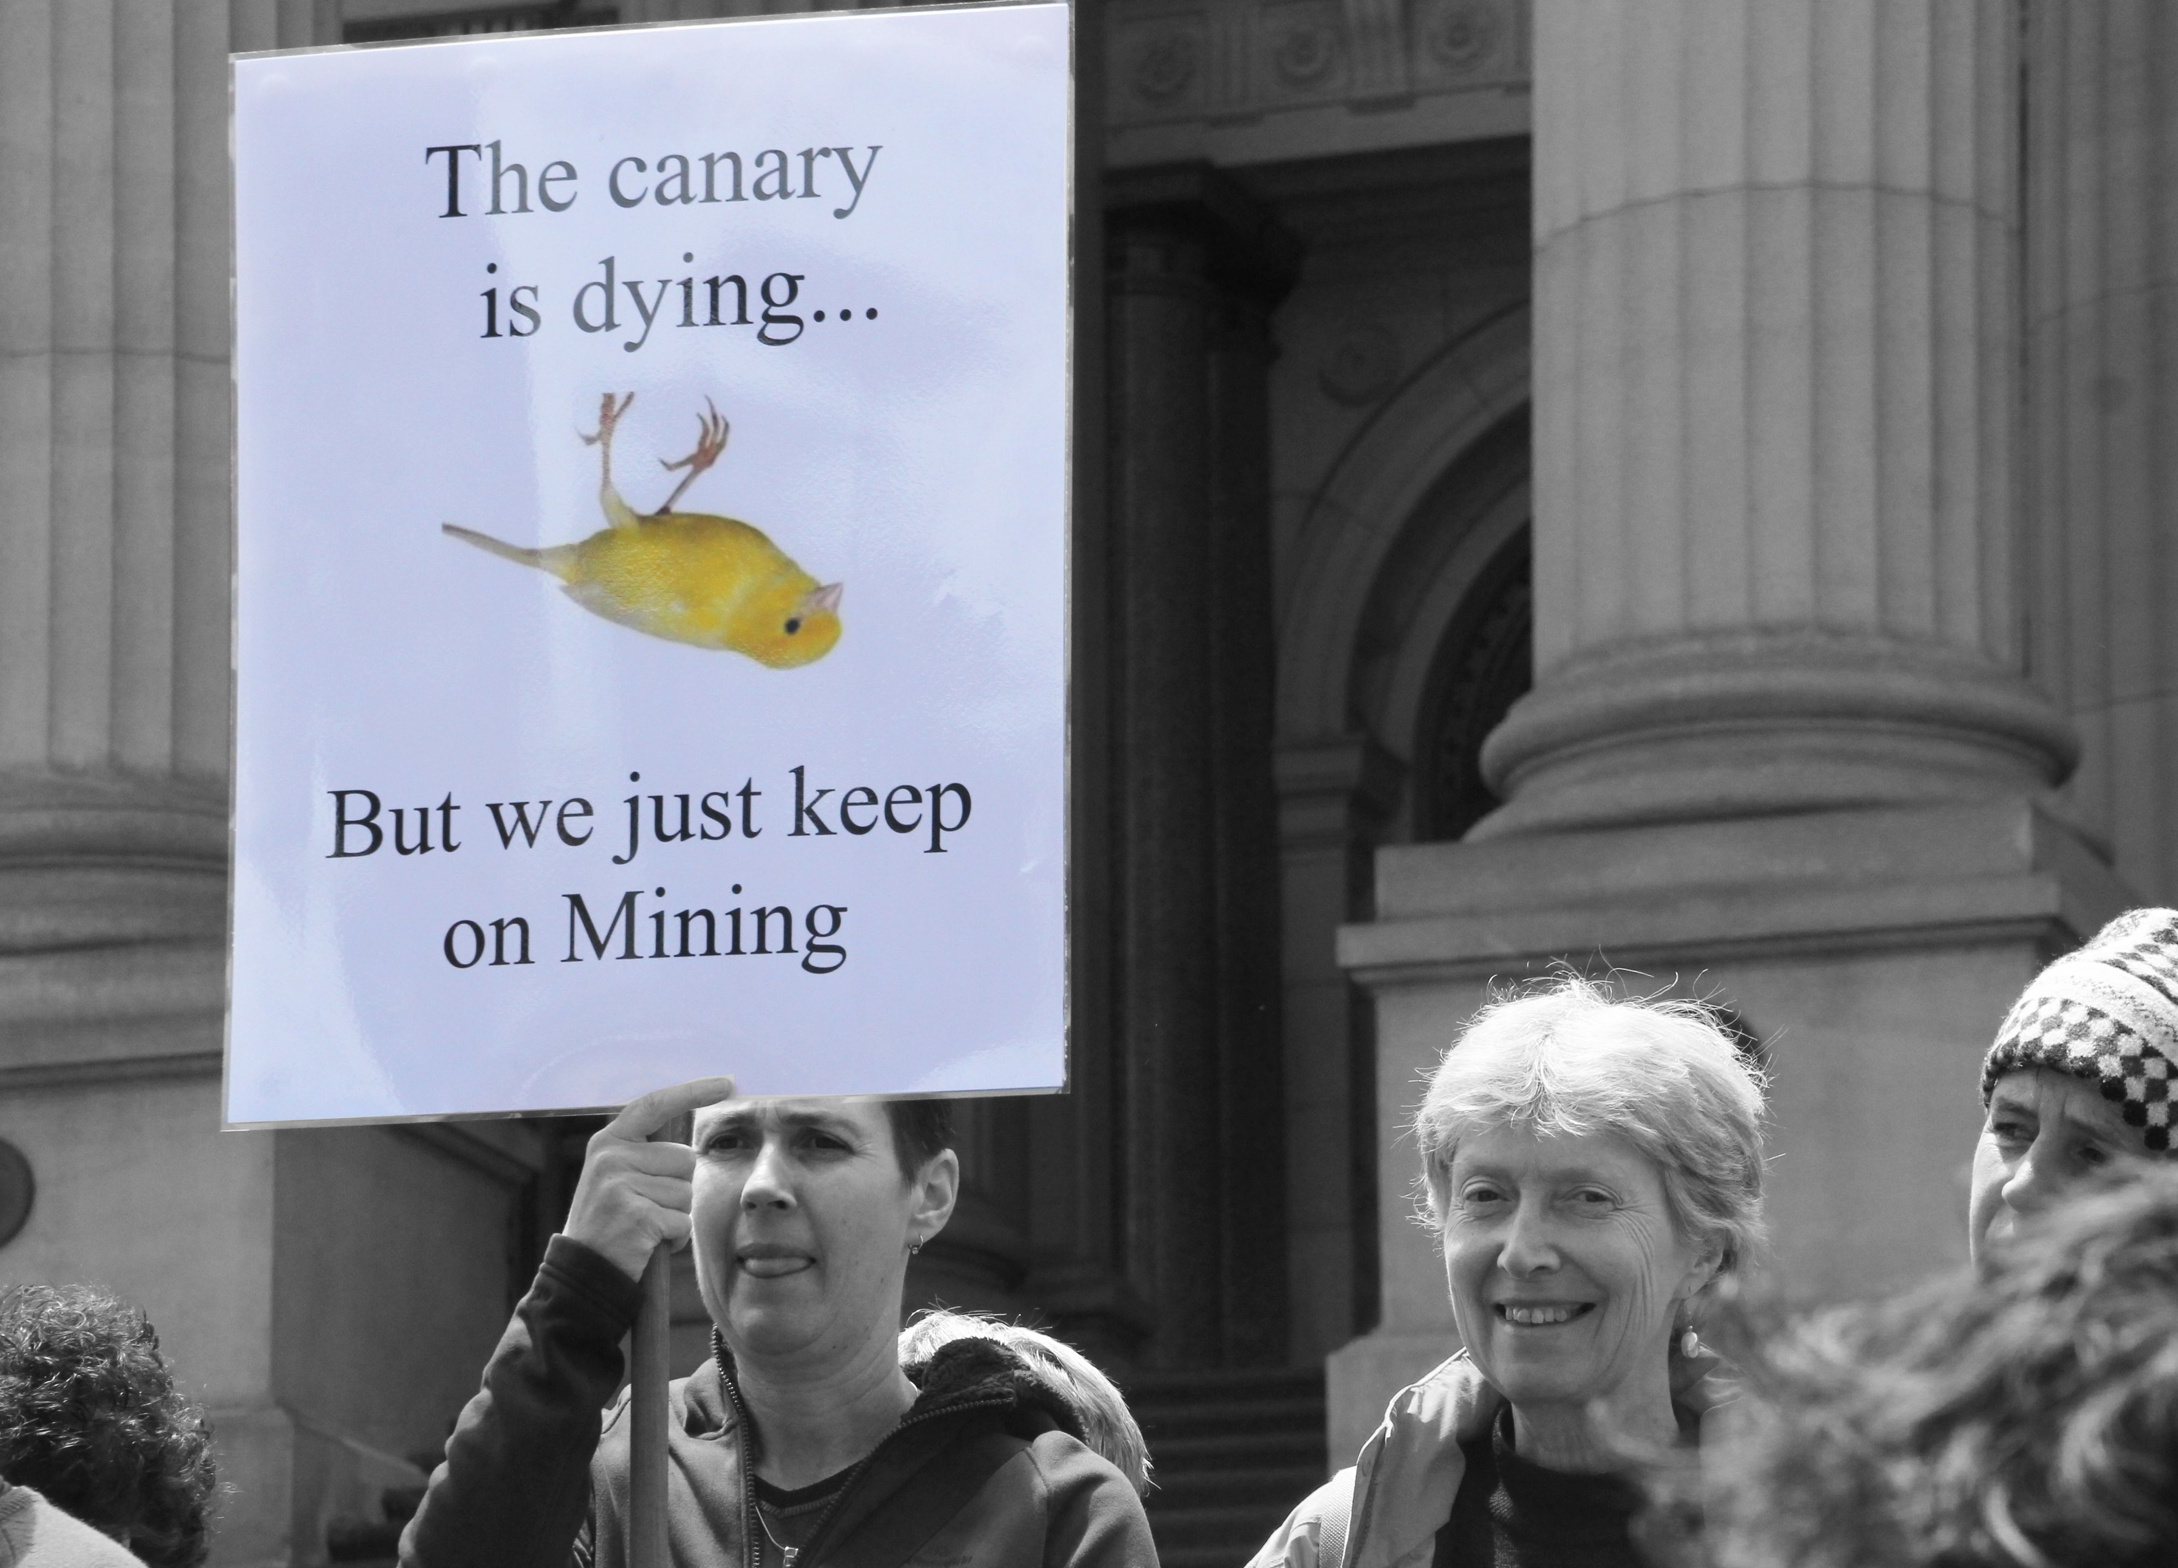
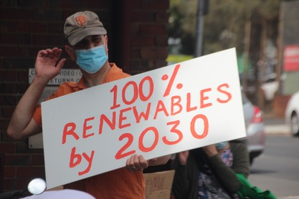
We only have one planet
Environmental Pollution
3 of the 10 dirtiest european coal plants are located in Poland
In which country/countries are the other 7 dirtiest coal plants located?
f the 10 dirtiest european coal plants are located in GERMANY
1. https://ember-climate.org/insights/research/top-10-emitters-in-the-eu-ets-2021/
2. John Englart – https://www.flickr.com/photos/takver/11308053925/ – CC BY-SA 2.0.
3. John Englart – https://www.flickr.com/photos/takver/51658831095/ – CC BY-SA 2.0.

Slide 14
We only have one planet
Environmental Pollution
3 of the 10 dirtiest European coal plants are located in Poland
In which country/countries are the other 7 dirtiest coal plants located?
7 of the 10 dirtiest European coal plants are located in GERMANY
1. https://ember-climate.org/insights/research/top-10-emitters-in-the-eu-ets-2021/
2. John Englart – https://www.flickr.com/photos/takver/11308053925/ – CC BY-SA 2.0.
3. John Englart – https://www.flickr.com/photos/takver/51658831095/ – CC BY-SA 2.0.

Slide 15
We only have one planet – Climate Change
2100 Warming Predictions
2100 Warming Predictions
Emissions and expected warming based on pledges and current policies
Global greenhouse gas emissions GtCO2/Year
Policies & Action (High) +2.9°C
Historical
Policies & Action (Low) +2.5°C
2030 targets only +2.4°C
Pledges & targets +2.1°C
Optimistic scenario +1.8°C
1.5° consistant +1.3°C
1990
2030
2100
Graph Recreated from https://climateactiontracker.org/documents/999/CAT_2021-11_PublicData_EmissionsPathways.xlsx

Slide 16
We only have one planet – Climate Change
2100 Warming Predictions
Emissions and expected warming based on pledges and current policies
2030 ambition gap (19-23 GtCO2e)
Policies & Action (High) +2.9°C
Global greenhouse gas emissions GtCO2/Year
Historical
Policies & Action (Low) +2.5°C
2030 targets only +2.4°C
Pledges & targets +2.1°C
Optimistic scenario +1.8°C
1.5° consistant +1.3°C
1990
2030
2100
Graph Recreated from https://climateactiontracker.org/documents/999/CAT_2021-11_PublicData_EmissionsPathways.xlsx

Slide 17
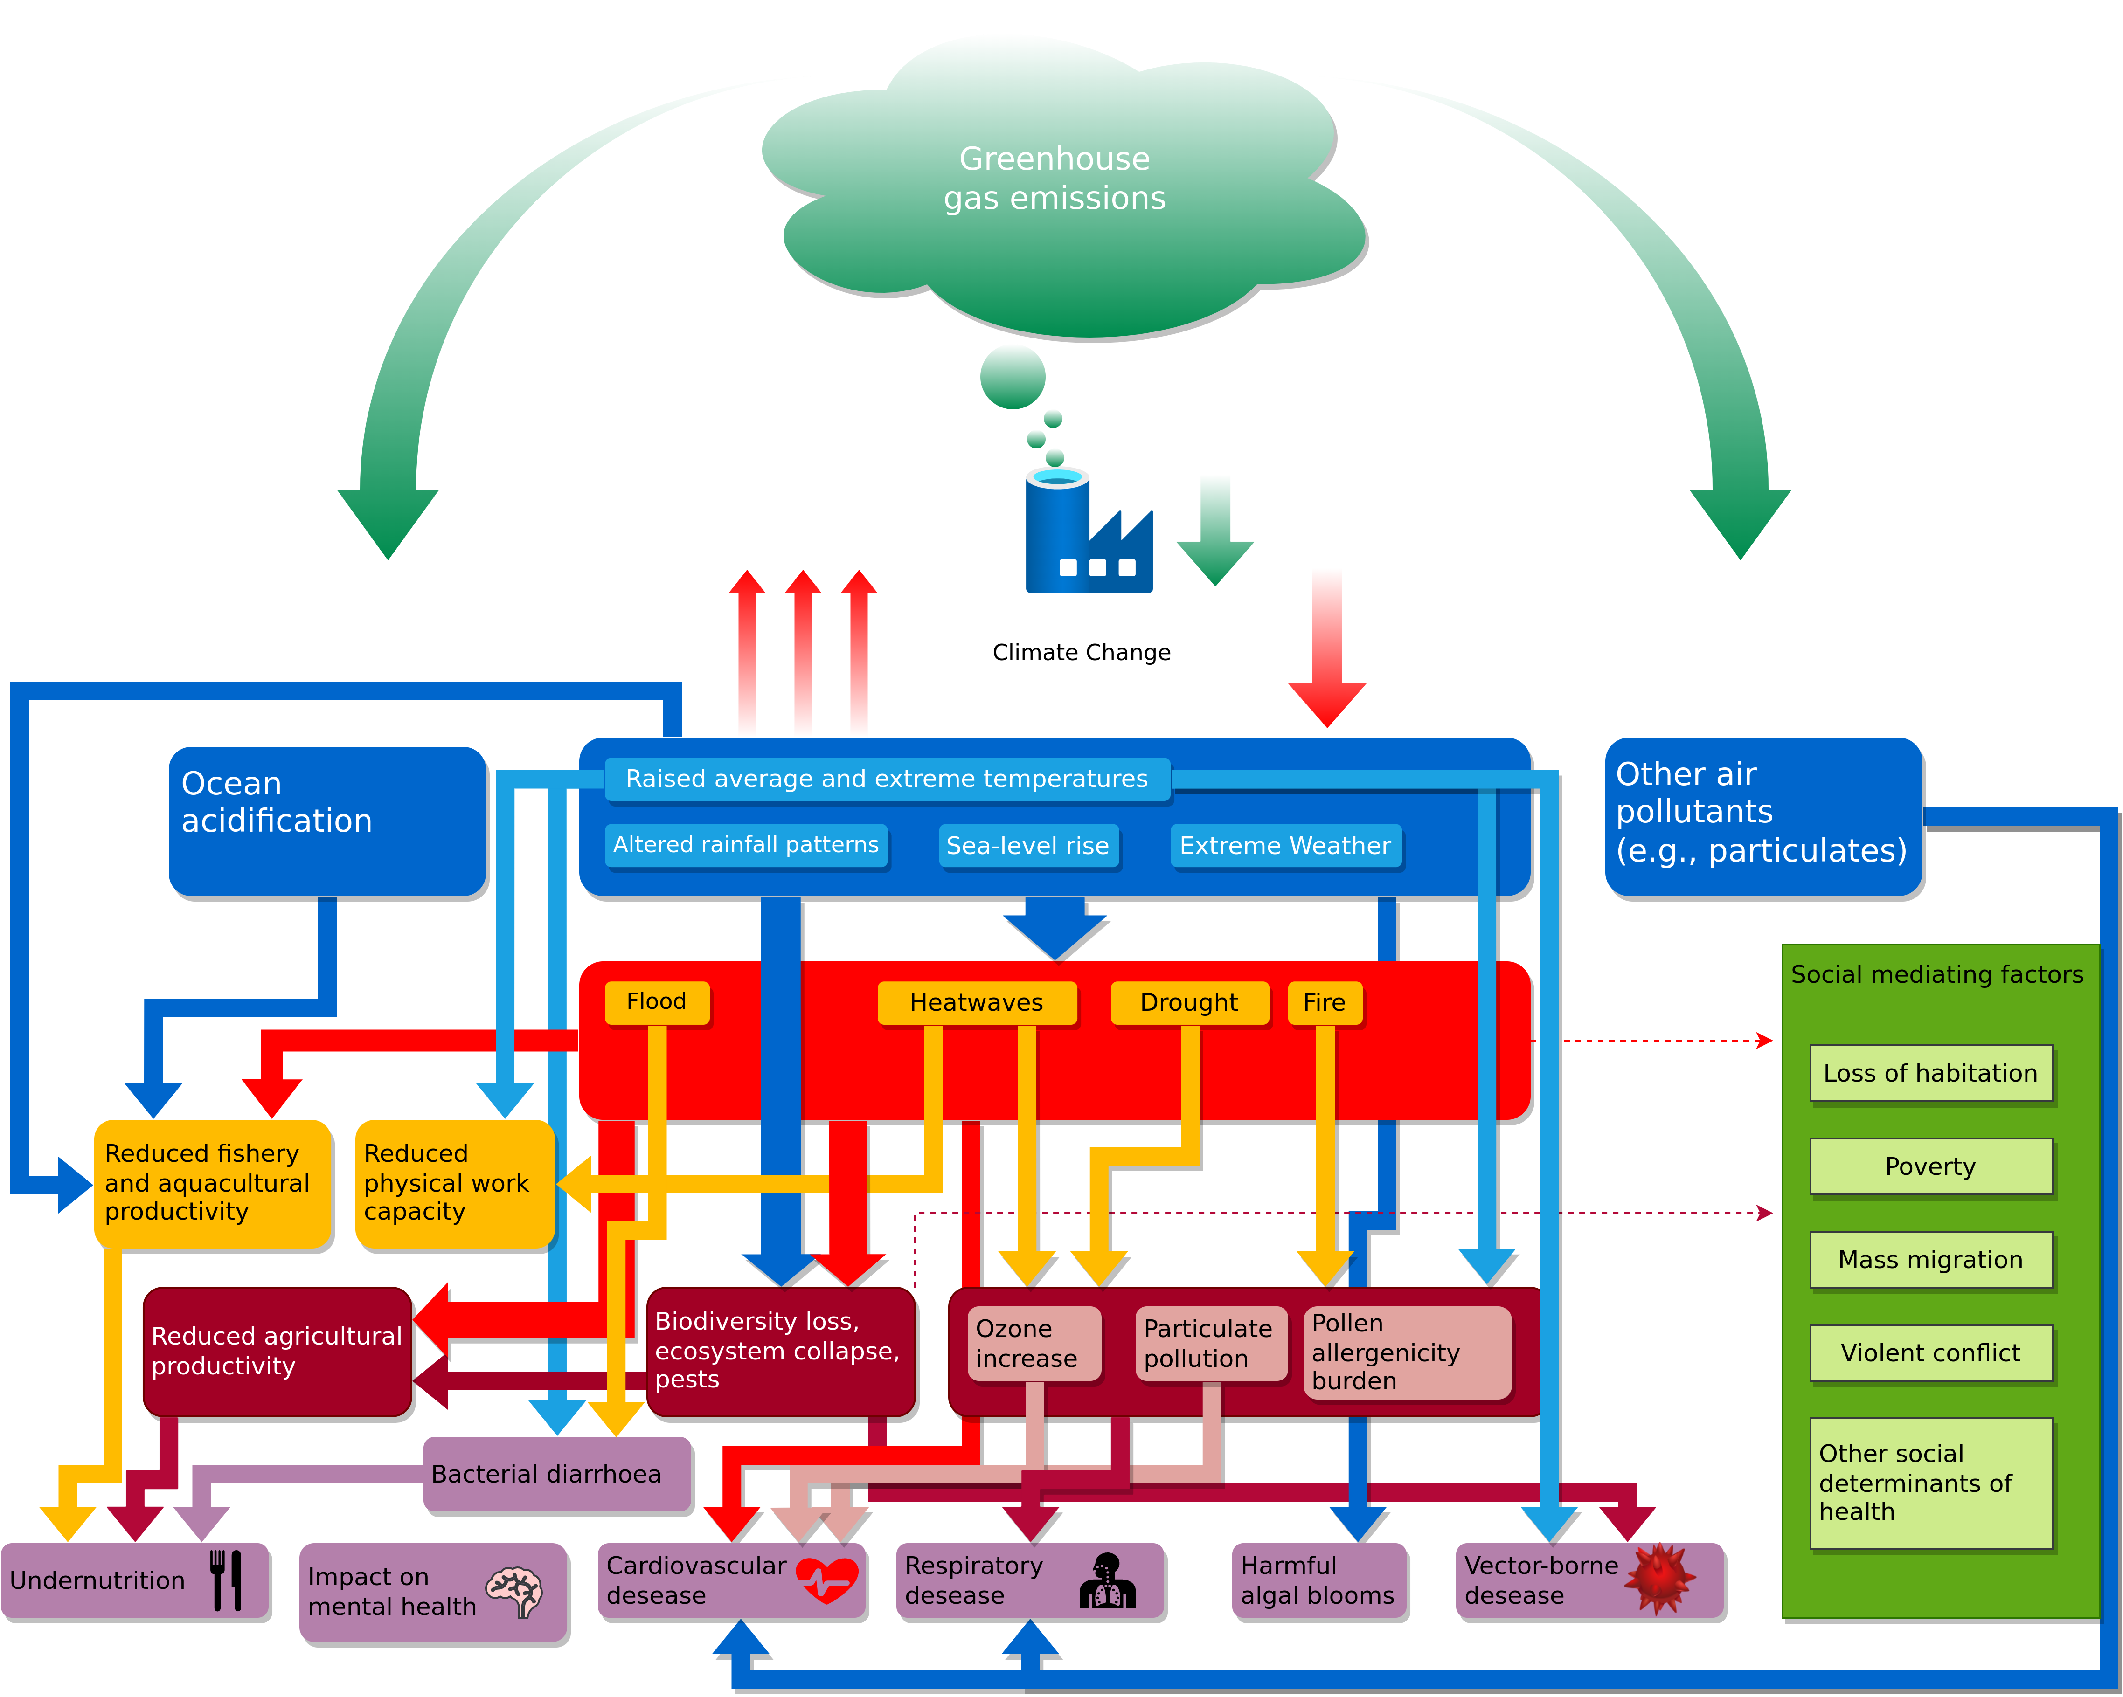
We only have one planet – Health Impact of Climate Change
Figure adapted from: Watts, Nick, et al. (2017) – The Lancet Countdown: Tracking Progress on Health and Climate Change.

Slide 18
2019 UN Climate Action Summit in New York
“change is coming, whether you like it or not”
Greta Thunberg
Click Me
(start video at 1:50)
Guardian News (2019) – https://www.youtube.com/watch?v=TMrtLsQbaok

Slide 19
3 Key Challenges of the 21st Century
Climate change / Adaption to climate change
Environmental pollution
Dwindling non-renewable ressources

Slide 20
Problem already solved?
So we just reduce our CO2 footprint and we are good?

Slide 21
Microsoft will be Carbon Negative by 2030
“By 2030 Microsoft will be carbon negative, and by 2050 Microsoft will remove from the environment all the carbon the company has emitted either directly or by electrical consumption since it was founded in 1975.”
https://blogs.microsoft.com/blog/2020/01/16/microsoft-will-be-carbon-negative-by-2030/

Slide 22
Apple will be Carbon Neutral by 2030
“Apple today unveiled its plan to become carbon neutral across its entire business, manufacturing supply chain, and product life cycle by 2030. The company is already carbon neutral today for its global corporate operations, and this new commitment means that by 2030, every Apple device sold will have net zero climate impact.”
July 2020
https://www.apple.com/newsroom/2020/07/apple-commits-to-be-100-percent-carbon-neutral-for-its-supply-chain-and-products-by-2030/

Slide 23
Polestar – 2030 Climate-neutral Car
“...we’re embarking on our greatest journey so far: challenging ourselves to create a climate-neutral car by 2030, by reducing emissions throughout supply chain and production.”
https://www.polestar.com/uk/news/striving-for-zero-the-2030-climate-neutral-car-plan/

Slide 24
Polestar – 2030 Climate-neutral Car
“...we’re embarking on our greatest journey so far: challenging ourselves to create a climate-neutral car by 2030, by reducing emissions throughout supply chain and production.”
“Relying on the current trend of offsetting by planting trees is not sustainable in the long run. It would mean using too much land, and the long-term carbon-storage capacity of forests and soils is not well known. Offsetting by planting trees also risks contributing to monocultures and loss of biodiversity. Additionally, there can be no guarantee that a forest won’t later be logged, devastated by a forest fire or altered by climate change.”
https://www.polestar.com/uk/news/striving-for-zero-the-2030-climate-neutral-car-plan/

Slide 25
Problem already solved?
It is not only about CO2…

Slide 26
Greenwashing?
Apple iPad Pro 11” 2018 | Gobs of adhesive hold most everything in place, making all repairs more difficult. The battery is secured with both easier-to-remove stretch-release tabs and conventional, non-removable adhesive. The USB-C port is modular and can be independently replaced.
Microsoft Surface Pro 6 2018 | All repairs require first removing the display assembly—which is stubbornly glued in place, expensive, and prone to shattering. The battery is firmly glued in place, with its connector pinned under the motherboard—requiring near-total disassembly for service. Once upon a time, Surface Pro storage was removable—but not in this version.
Apple iPad Air 3 2019 | Battery replacement is possible, but still unnecessarily difficult. Gobs of adhesive hold many parts and cables in place, complicating all repairs. Many components are modular and can be replaced independently, but the Lightning port is soldered to the logic board.
Apple iPad 7 2019 | As with all iPads, a solid barrier of very strong adhesive hinders all repairs. The Lightning port, a common point of failure, is soldered to the logic board. More adhesive holds nearly everything else in place. Battery and logic board replacements are particularly obnoxious.
Apple iPad Mini 5 2019 | Battery replacement is possible, but still unnecessarily difficult. Gobs of adhesive hold many parts and cables in place, complicating all repairs. Removing the home button is tough, and will be required for display replacement if you want to keep Touch ID functionality.
https://www.ifixit.com/tablet-repairability

Slide 27
How much am I contributing to this mess?
What is your Ecological Footprint?
How many planets do we need if everybody lives like you?
When is your personal Overshoot Day?
Compute YOUR ecological footprint
https://www.footprintcalculator.org

Slide 28
Origins of the Carbon Footprint

Slide 29
Origins of the Carbon Footprint
“The first step to reducing your emissions is to know where you stand. Find out your #carbonfootprint with our new calculator & share your pledge today!” - BP (British Petroleum)

Slide 30
Who Emits CO2?
100 companies produced more than 70% of the world’s greenhouse gas emissions between 1988 and 2017
Guess who is on the list?
https://www.theguardian.com/sustainable-business/2017/jul/10/100-fossil-fuel-companies-investors-responsible-71-global-emissions-cdp-study-climate-change

Slide 31
Who Emits CO2?
100 companies produced more than 70% of the world’s greenhouse gas emissions between 1988 and 2017
Guess who is on the list?
China (Coal) → 14.32%
Saudi Arabian Oil Company (Aramco) → 4.50%
Gazprom OAO → 3.91%
National Iranian Oil → 2.28%
ExxonMobil Corp → 1.98%
Coal India → 1.87%
Petroleos Mexicanos (Pemex) → 1.87%
Russia (Coal) → 1.86%
Royal Dutch Shell PLC → 1.67%
China National Petroleum Corp (CNPC) → 1.56%
BP PLC → 1.53%
Chevron Corp → 1.31%
https://www.theguardian.com/sustainable-business/2017/jul/10/100-fossil-fuel-companies-investors-responsible-71-global-emissions-cdp-study-climate-change

Slide 32
Who Emits CO2?
100 companies produced more than 70% of the world’s greenhouse gas emissions between 1988 and 2017
Guess who is on the list?
China (Coal) → 14.32%
Saudi Arabian Oil Company (Aramco) → 4.50%
Gazprom OAO → 3.91%
National Iranian Oil → 2.28%
ExxonMobil Corp → 1.98%
Coal India → 1.87%
Petroleos Mexicanos (Pemex) → 1.87%
Russia (Coal) → 1.86%
Royal Dutch Shell PLC → 1.67%
China National Petroleum Corp (CNPC) → 1.56%
BP PLC → 1.53%
Chevron Corp → 1.31%
Blaming individuals and denying any responsibility → great strategy!
https://www.theguardian.com/sustainable-business/2017/jul/10/100-fossil-fuel-companies-investors-responsible-71-global-emissions-cdp-study-climate-change

Slide 33
Emotional Ecological Liabilities – Watson and Chomsky

Slide 34

Emotional Ecological Liabilities – Watson and Chomsky

Slide 35
What are you gonna tell your children?

Slide 36
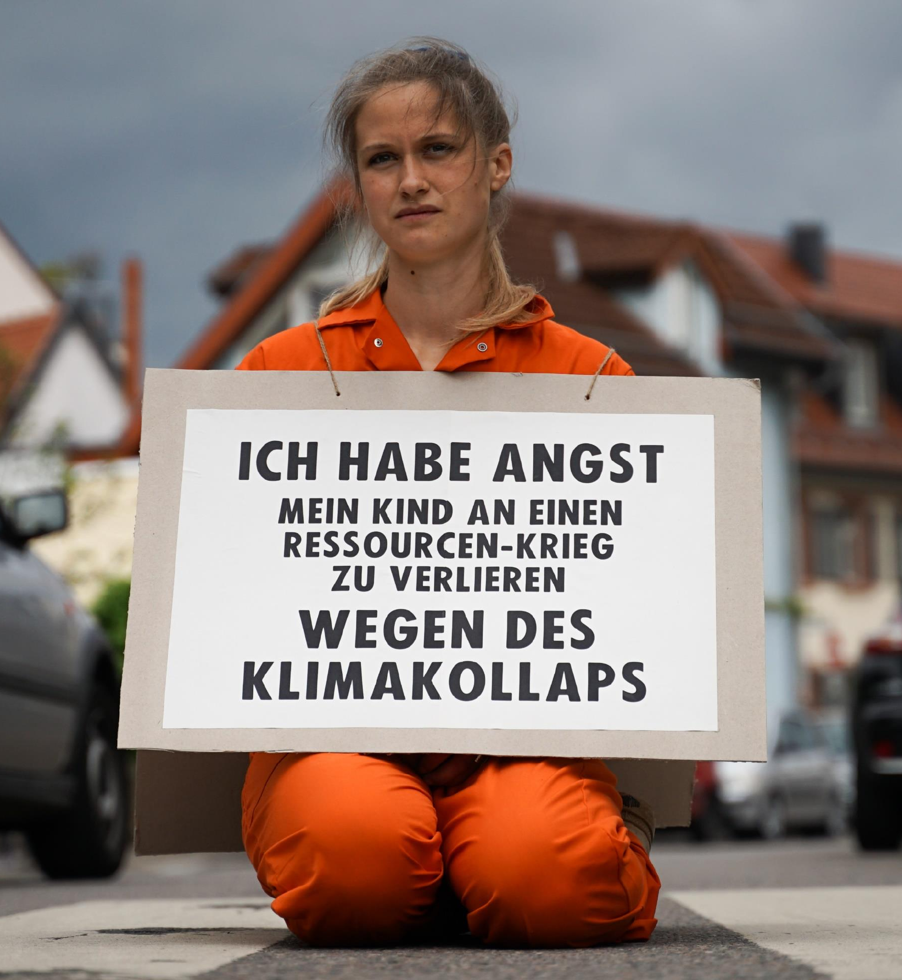
What are you gonna tell your children?
“I am afraid of losing my child to a resource war because of a climate collapse”
XR Strategiepapier 2022 – Pusteblumen und Hype. Bilder: Sebastian Höhn, Joe Pohl, Sandra Doneck, Alessandro Brönnimann

Slide 37
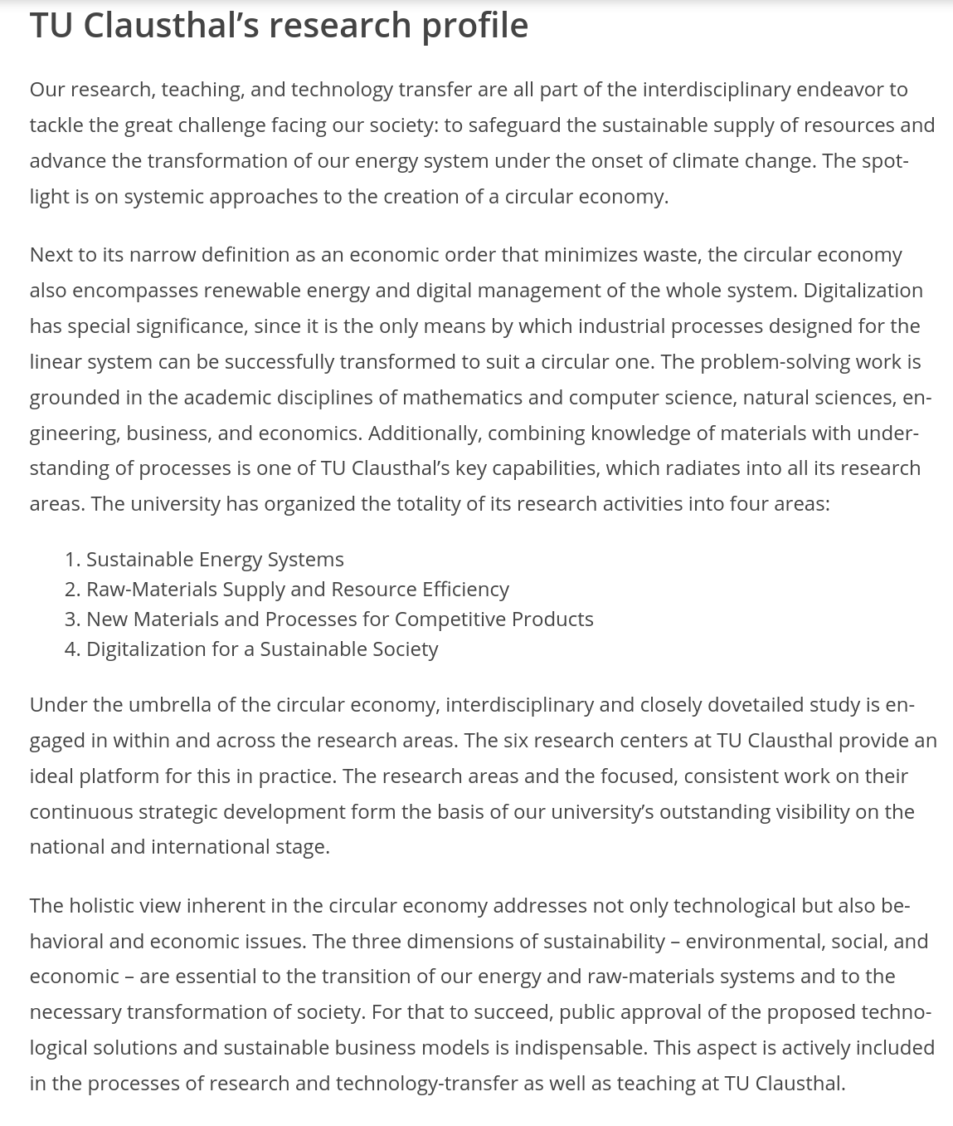
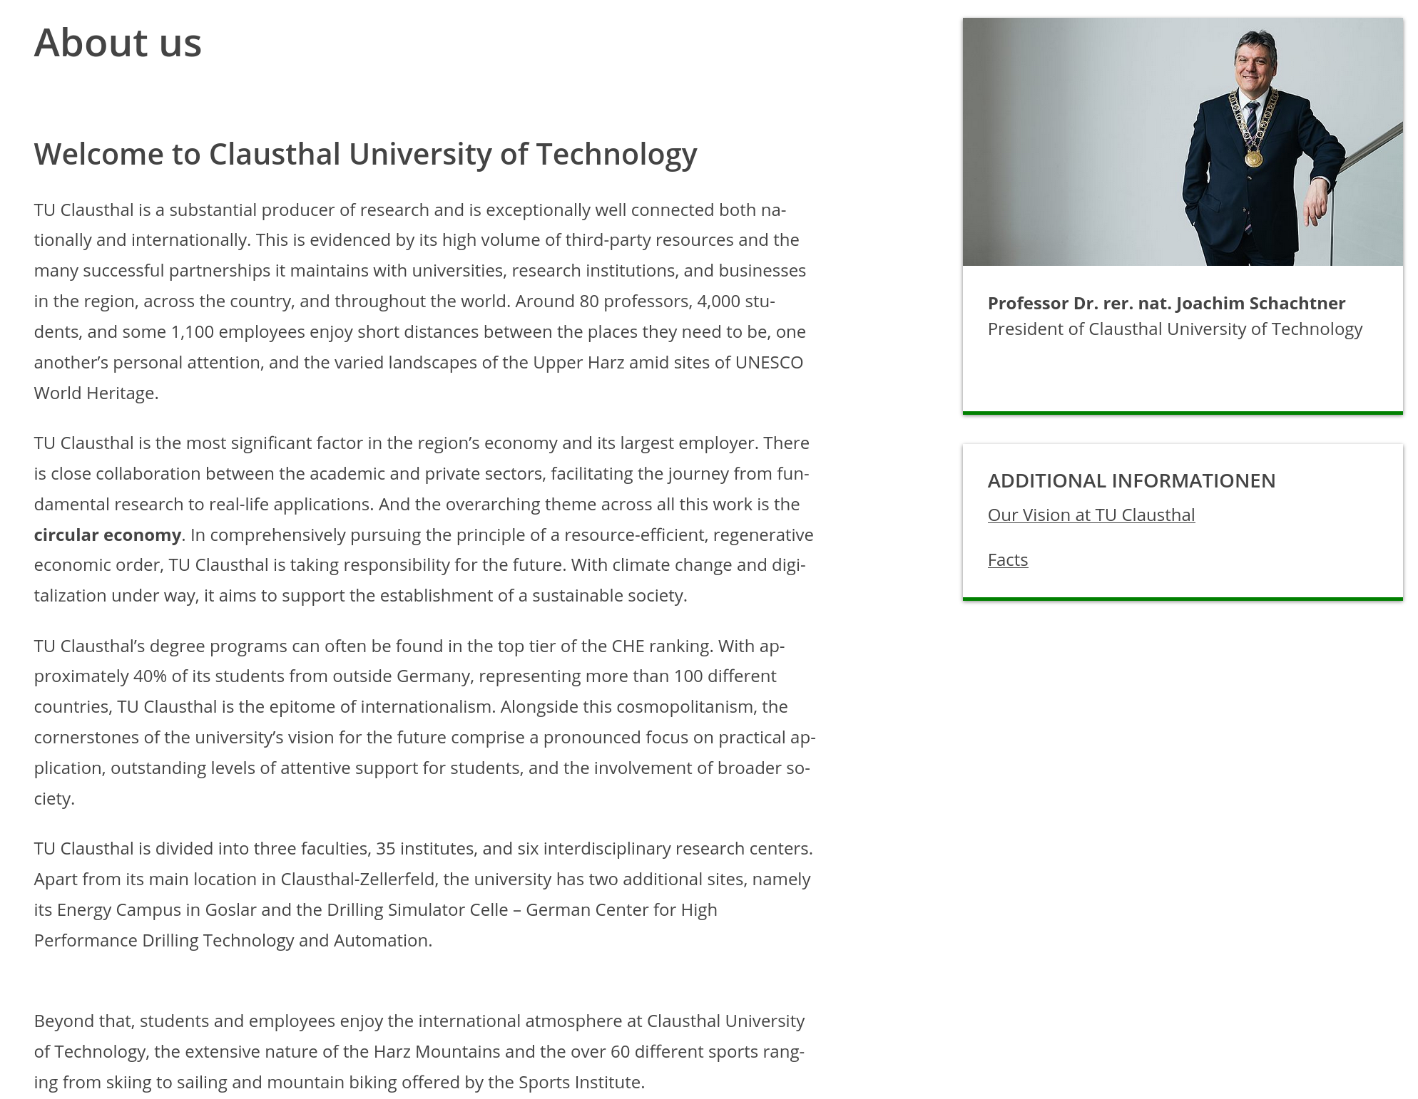
TU Clausthal – Research Profile
https://www.tu-clausthal.de/en/university/about-us
Notes:
<number>

Slide 38
The linear (industrial) Economy

Slide 39
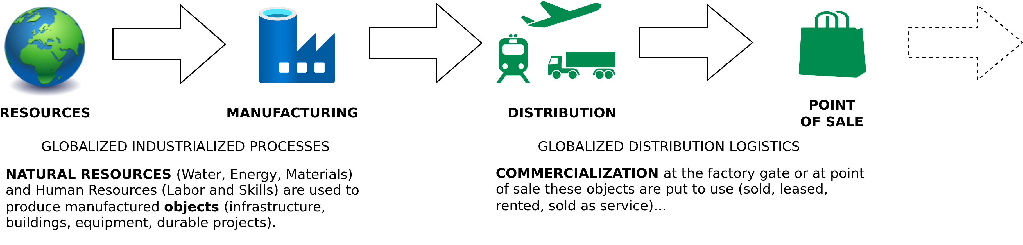
The Linear (Industrial) Economy
Image adapted from: Walter R. Stahel (2019) – The Circular Economy: A User’s Guide.

Slide 40
Linear Economy – Definition

Slide 41
Linear Economy – Definition
“Take – Make – Dispose”

Slide 42
Linear Industrial Economy – Definition
“Its objectives are to maintain value (not to create value added), to optimise stock management (not flows) and to increase the efficiency of using goods (not of producing goods)”
Walter R. Stahel (2019) – The Circular Economy: A User’s Guide.

Slide 43
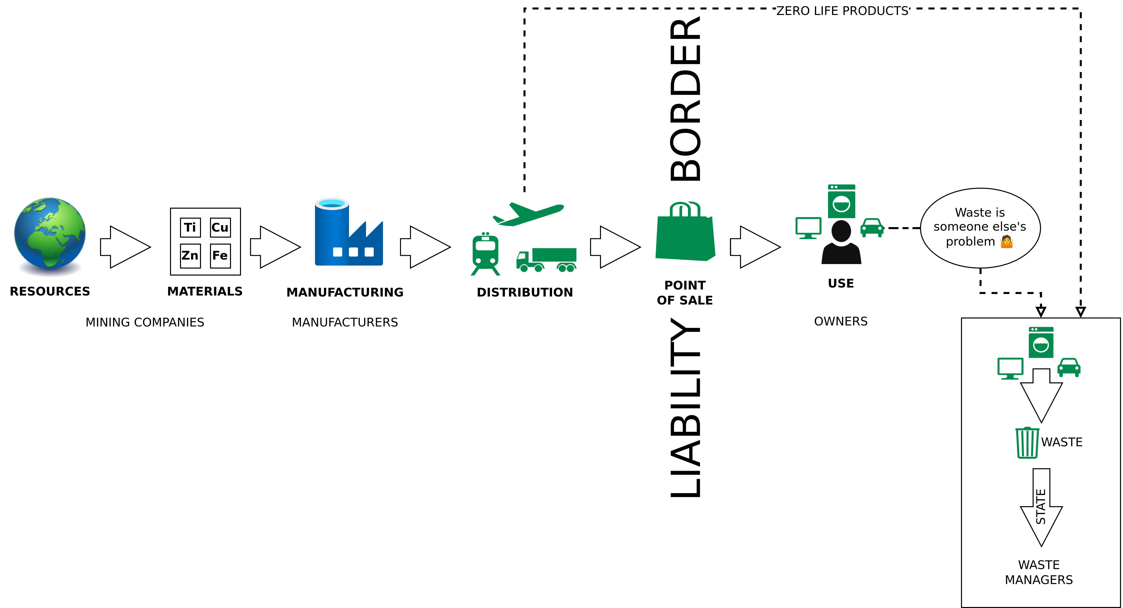
The Linear (Industrial) Economy – Waste Management as last Step
Image adapted from: Walter R. Stahel (2019) – The Circular Economy: A User’s Guide.

Slide 44
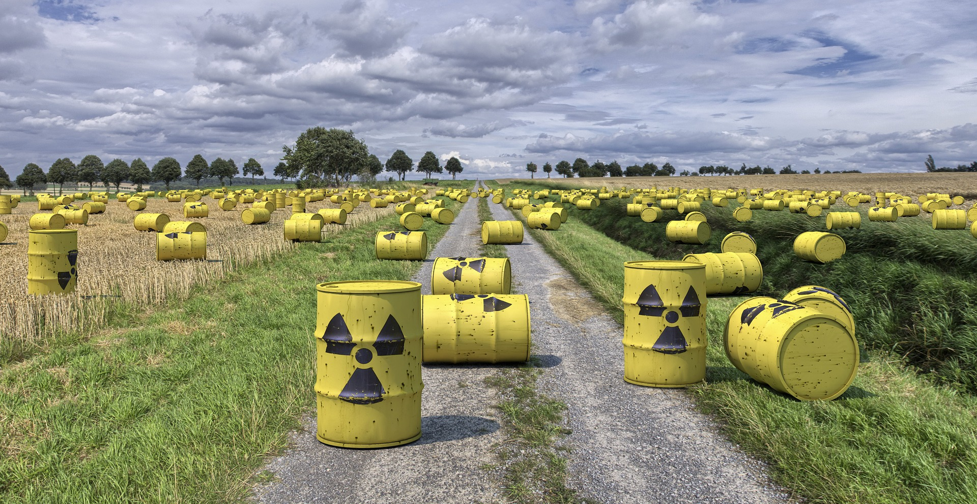
Horrible Waste Management – Example 1

Slide 45
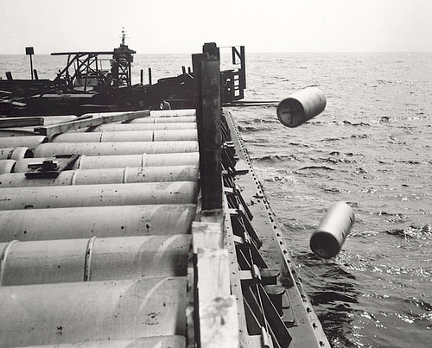
Horrible Waste Management – Example 1
"Nuclear waste" by aaadrian365 is licensed with CC BY-NC 2.0. To view a copy of this license, visit https://creativecommons.org/licenses/by-nc/2.0/

Slide 46
Horrible Waste Management – Example 1
→ 40,000 generations will have to live with the waste
→ 2 generations profited from cheap nuclear energy
https://www.spiegel.de/wissenschaft/technik/endlager-suche-was-wie-viel-und-wohin-damit-die-deutsche-atommuell-bilanz-a-7a153ba3-029a-4e55-adaf-3312b7427d9e

Slide 47
Horrible Waste Management – Example 1
→ 40,000 generations will have to live with the waste
→ 2 generations profited from cheap nuclear energy
→ 40,000 generation will have to live with the waste
https://www.spiegel.de/wissenschaft/technik/endlager-suche-was-wie-viel-und-wohin-damit-die-deutsche-atommuell-bilanz-a-7a153ba3-029a-4e55-adaf-3312b7427d9e

Slide 48
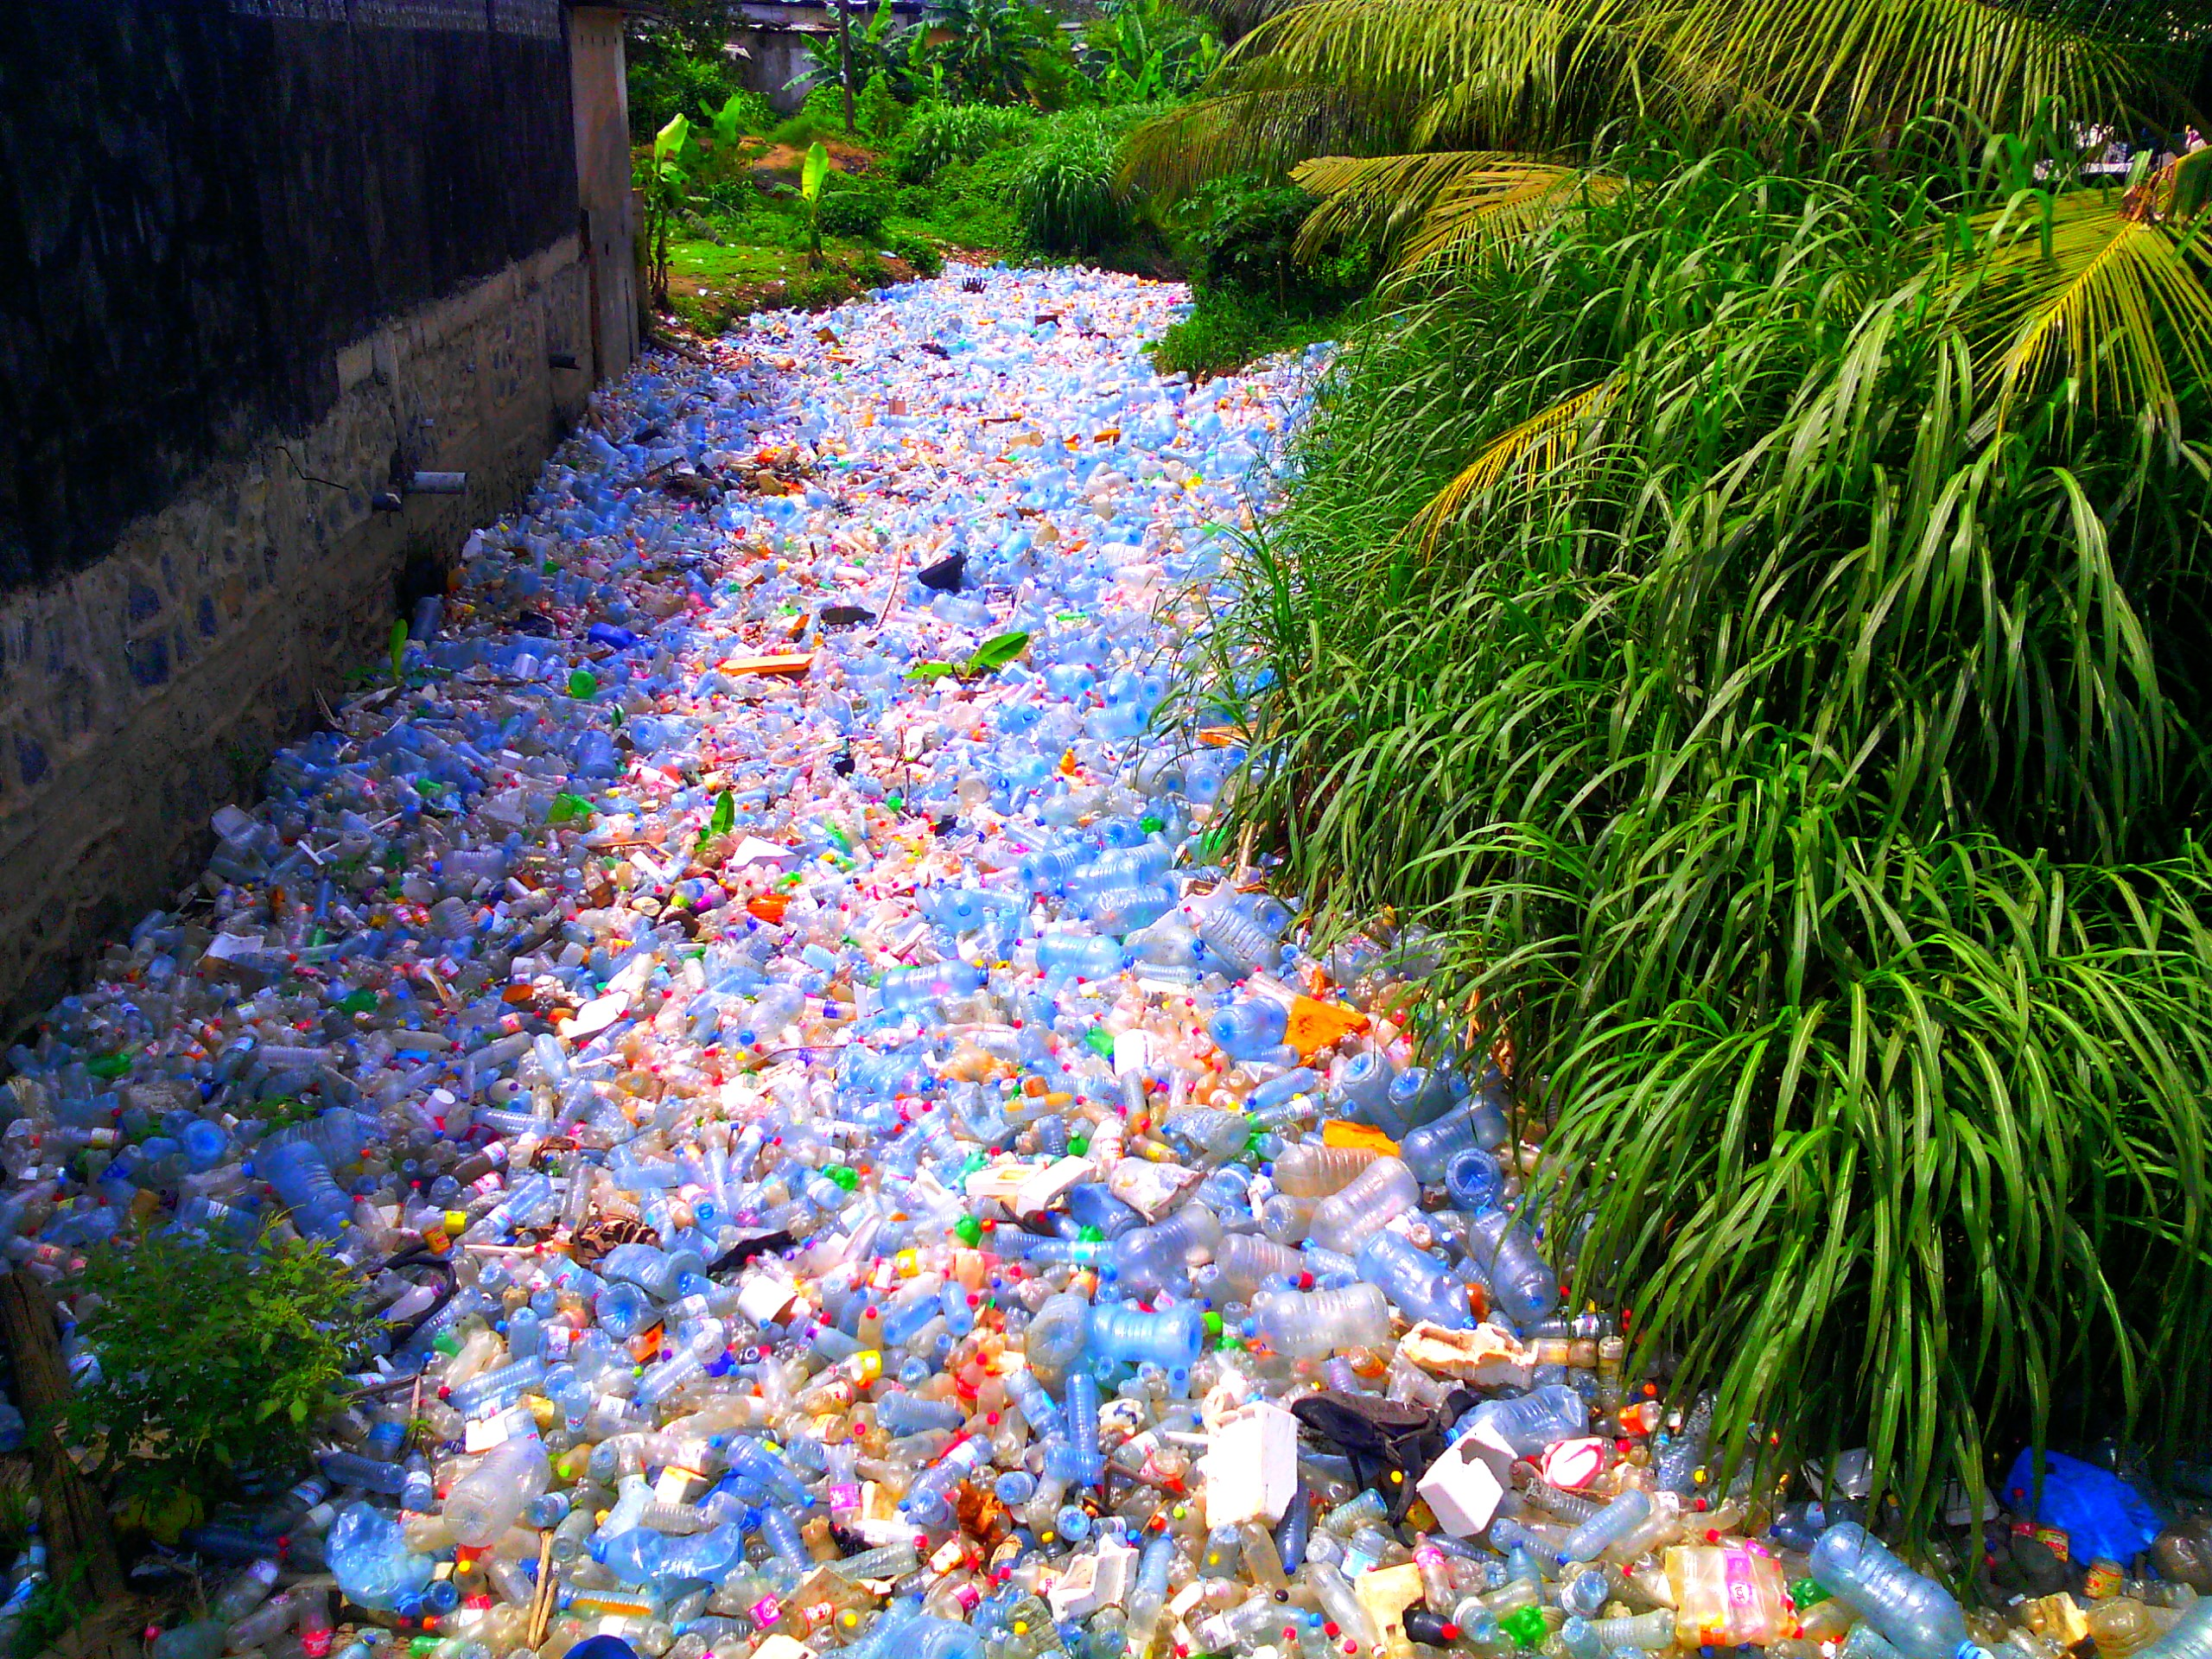
Horrible Waste Management – Example 2
"Pollution Plastique" by Mouenthias is licensed with CC BY-SA 4.0. To view a copy of this license, visit https://creativecommons.org/licenses/by-sa/4.0/

Slide 49
Horrible Waste Management – Example 2
We are consuming about 2000 tiny pieces of plastic every week.
That is a credit card every week!
That’s approximately 21 grams a month, or just over 250 grams a year.
"Pollution Plastique" by Mouenthias is licensed with CC BY-SA 4.0. To view a copy of this license, visit https://creativecommons.org/licenses/by-sa/4.0/
Wijnand de Wit and Nathan Bigaud for the WWF (2019) – No Plastic in Nature: Assessing Plastic Ingestion from Nature to People.

Slide 50
Horrible Waste Management – Example 2
We are consuming about 2000 tiny pieces of plastic every week.
That is a credit card every week!
That’s approximately 21 grams a month, or just over 250 grams a year.
"Pollution Plastique" by Mouenthias is licensed with CC BY-SA 4.0. To view a copy of this license, visit https://creativecommons.org/licenses/by-sa/4.0/
Wijnand de Wit and Nathan Bigaud for the WWF (2019) – No Plastic in Nature: Assessing Plastic Ingestion from Nature to People.

Slide 51
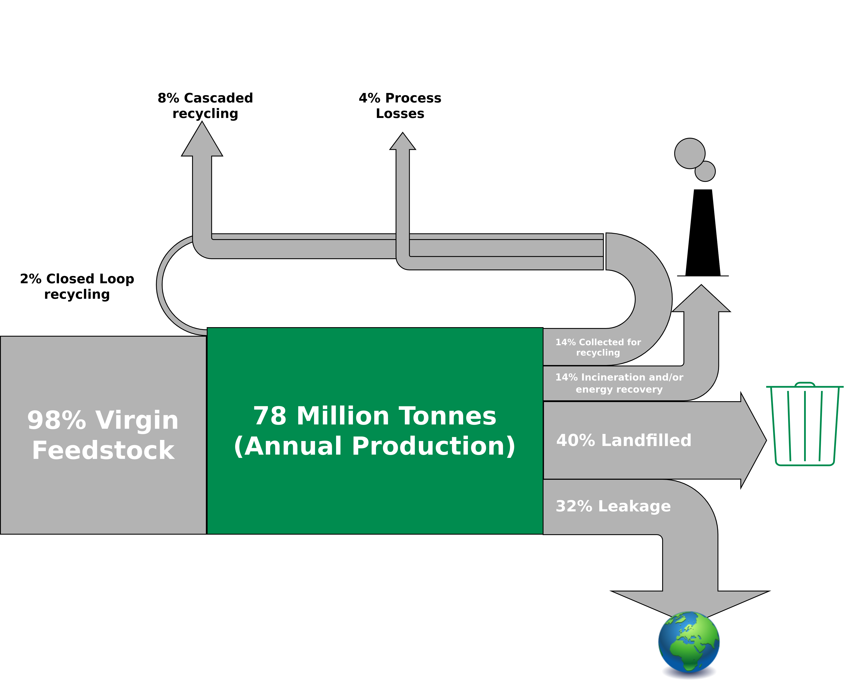
Horrible Waste Management – Example 2
Global Flows of Plastic Packaging Materials in 2013
Figure adapted from: Ellen MacArthur Foundation (2016) – THE NEW PLASTICS ECONOMY

Slide 52
Horrible Waste Management – Example 2
Global Flows of Plastic Packaging Materials in 2013
In 2050, there will be more plastic than fish in the ocean (by weight) is a credit card every week!
That’s approximately 21 grams a month, or just over 250 grams a year.
Figure adapted from: Ellen MacArthur Foundation (2016) – THE NEW PLASTICS ECONOMY

Slide 53
The Limits to Recycling
Recycling often requires a lot of energy
Some materials cannot be recycled at all (yet)
Impurities are challenging
Often requires a lot of manual labor
Recycled material often with lower quality than input material
False sense of safety!
I am not saying you should stop recycling!
→ Recycling is great but it is better to make sure that we do not have to recycle anything.
→ Buying less (e.g., only the essentials) is way more effective.

Slide 54
The Limits to Recycling
Recycling often requires a lot of energy
Some materials cannot be recycled at all (yet)
Impurities are challenging
Often requires a lot of manual labor
Recycled material often with lower quality than input material
False sense of safety!
I am not saying you should stop recycling!
→ Recycling is great but it is better to make sure that we do not have to recycle anything.
→ Buying less (e.g., only the essentials) is way more effective.
“We buy things we don't need, to impress people we don't like.” - Tyler Durden / Chuck Palahniuk

Slide 55
Waste Management
Waste = Inefficiency

Slide 56
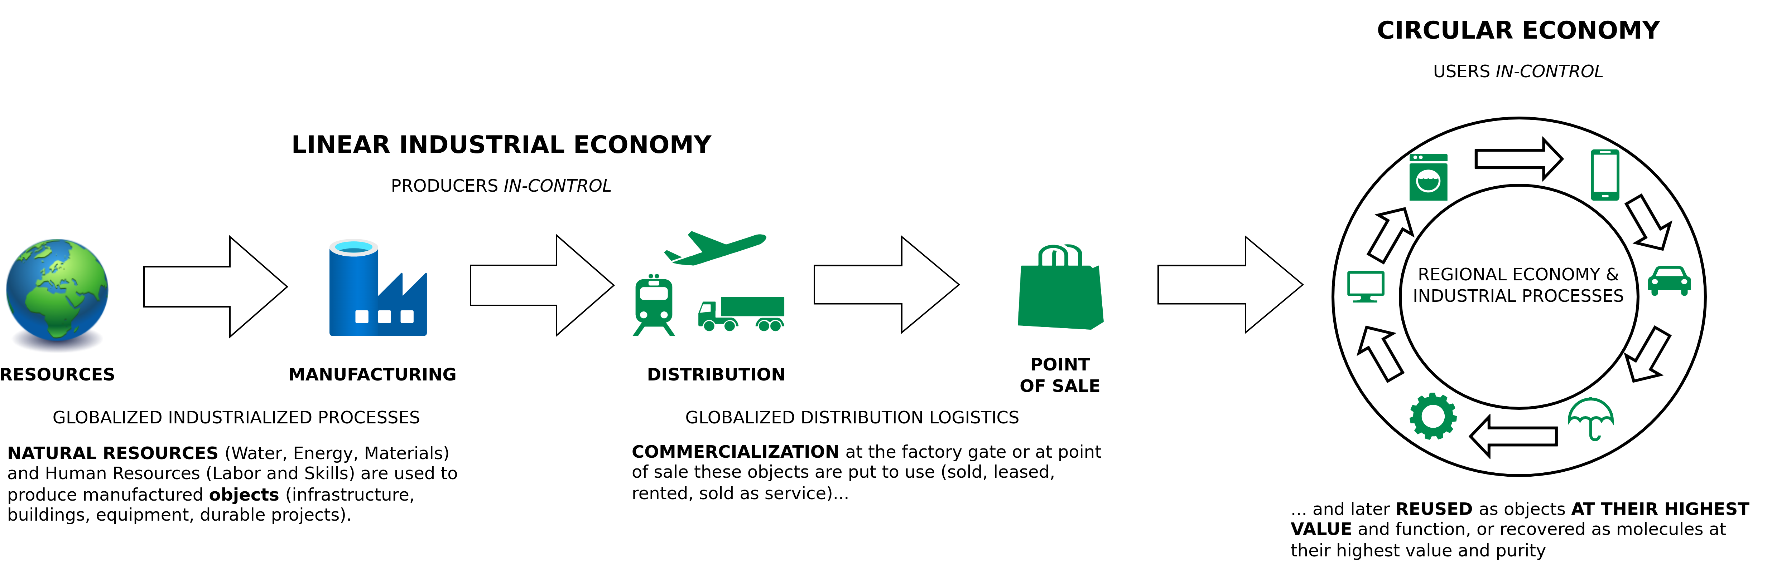
The Linear (Industrial) Economy
Image adapted from: Walter R. Stahel (2019) – The Circular Economy: A User’s Guide.

Slide 57
Emerging Technologies for the Circular Economy
Lecture 2: Circular Economy
Prof. Dr. Benjamin Leiding (Clausthal)
Dr. Arne Bochem (Göttingen)
M.Sc. Anant Sujatanagarjuna (Clausthal)
M.Sc. Shohreh Kia (Clausthal)
Notes:
<number>

Slide 58
Questions?

